Slide 1
Introduction to Android with Kotlin
PlovDev
25 Nov 2017

Slide 2




Who Am I?
Doncho Minkov
Principal Technical Trainer @ Telerik Academy
13+ years in IT
7 as a trainer
Front-end developer by heart
Software developer by need
Experience with all popular mobile platforms
Android, iOS, Windows
Fluent in Android, Node.js, Angular, Java, C++
Deep knowledge of Data Structures and Algorithms
Github
LinkedIn
E-mail

Slide 3
Telerik Academy: 8 Years of Traction in a Nutshell

Slide 4
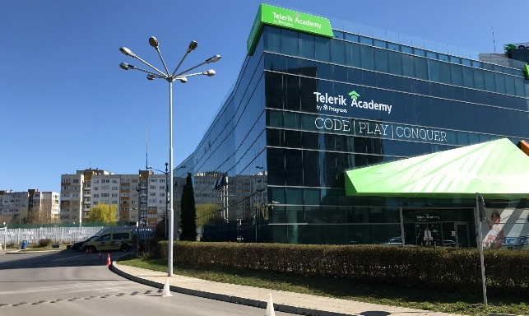

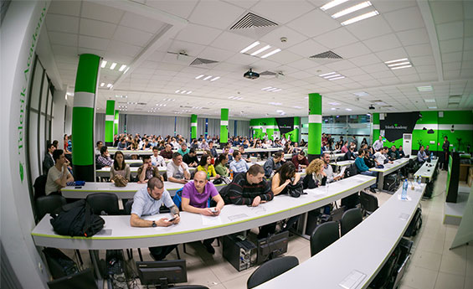
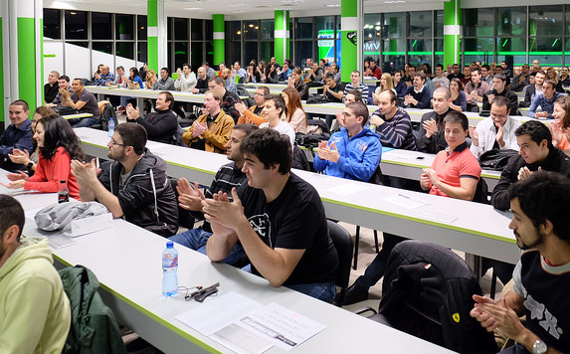
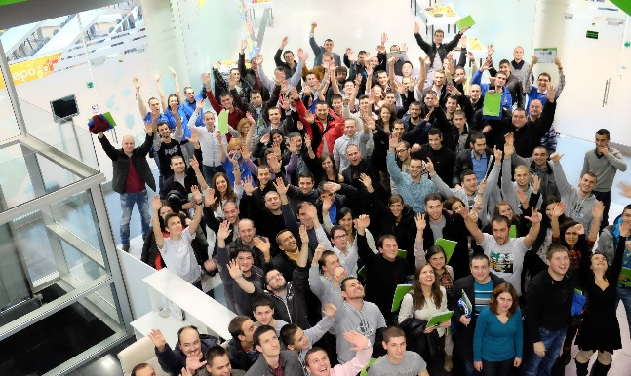
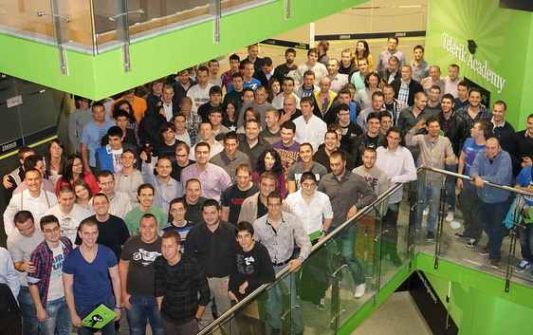
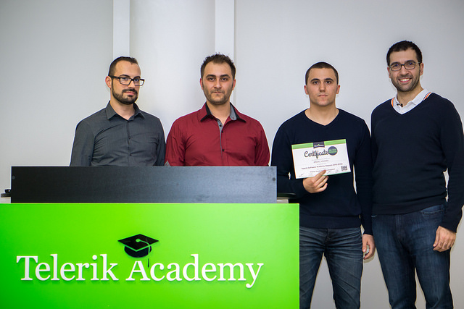
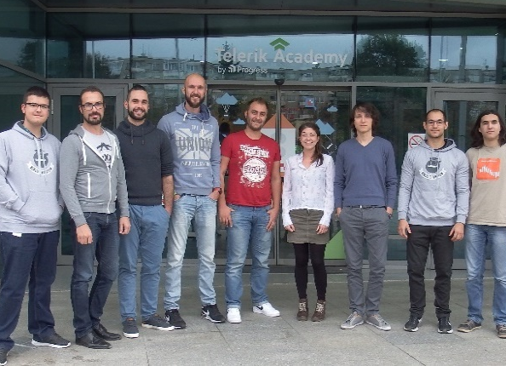
History and Achievements
The first large initiative for free IT education in Bulgaria
Massive effect on the ecosystem since 2009:
12,000+ people trained on-site
45,000 people used the online training resources
25+ courses, 3,800+ video lessons with 6M views on YouTube
For people aged 6 to 66+ years:
Kids/youth: spark love for technology and learning in general
Young job-seekers: get their first IT job with a flying start
Working professionals: switch careers to the more promising IT sector
100% success rate of Telerik Academy graduates:
67% start working within 1-2 months of graduation
The rest start working shortly after that
Geo coverage throughout Bulgaria:
36 locations in 11 towns for the Telerik Kids Algo Academy
Still just in Sofia with the other formats
Not a substitute, but addition to the state education system:
A bridge between the state education and the first job
More dynamic, practical and market-oriented program

Slide 5
Table of Contents
What is Android?
What is Kotlin?
Why Kotlin?
Kotlin Features

Slide 6
What is Android?
Android is a mobile OS
Supported by Google
Open-source
Languages for developing Android apps
Java
C/C++
JavaScript (React Native/NativeScript)
C# (Xamarin)
Now Kotlin in Android!
Google I/O ’17
https://www.youtube.com/watch?v=d8ALcQiuPWs

Slide 7
What is Kotlin?
Kotlin is a statically-typed programming
Developed by JetBrains
Runs on the JVM
Can be compiled to JavaScript
Kotlin is a interpoletable with Java
Any Java code can be used in Kotlin and vice versa
The “fun” language

Slide 8
Why Kotlin? (instread of Java)
New and shiny programming language
First official release in 2016
Java for Android is stuck in Java 7
No LAMBDAs
No extentions (interfaces)
No forEach(), map(), etc…
Kotlin supports all of the above
Kotlin has null-checks (guards)
Very similar to Swift

Slide 9
Kotlin in Android
Since Android Studio 3.X Kotlin is one of the first-class languages to develop Android apps
Can paste Java code and it is translated to Kotlin
Works good enough for small files
Kotlin works well with all current Android libs
OkHTTP, Retrofit, ReactiveX, etc…
Kotlin can extend Java classes and interfaces
i.e. Kotlin implementation of a Java interface

Slide 10
Kotlin Features

Slide 11
Activities
class ListActivity : AppCompatActivity() {
override fun onCreate(savedInstanceState: Bundle?) {
super.onCreate(savedInstanceState)
setContentView(R.layout.activity_list)
adapter = ArrayAdapter<String>(…)
listView = findViewById<ListView>(R.id.lv_names);
listView.adapter = adapter
}
}

Slide 12
Attaching Events
btn.setOnClickListener({
Toast.makeText(this, "Success!", Toast.LENGTH_LONG)
.show()
})
btn.setOnClickListener({ btn ->
Toast.makeText(this, "Success!", Toast.LENGTH_LONG)
.show()
})

Slide 13
Extention Methods
fun AppCompatActivity.showLoading() {
// show loader
}
fun AppCompatActivity.hideLoading() {
// show loader
}
Now all activities have showLoading() and hideLoading()!

Slide 14
LAMBDAs
books.filter { it.platform == "Android" }
.map { it.name }
.forEach(adapter::add)

Slide 15
Null checks
Get the value or null
view: View? = listView ?: null
Throw expressions, throw if value is null
view: View = listView ?: throw Throwable("Null view")
Type-safe invocation:
view?.findViewById<Button>(R.id.btn)?.visibility
And they are done compile time

Slide 16
Works Well with Java libs
Example: RxAndroid
booksRepository.listAll() .subscribeOn(Schedulers.io()) .observeOn(AndroidSchedulers.mainThread()) .subscribe({ books -> adapter.clear() adapter.addAll(books.map { it.name }) })

Slide 17
Thank you!
Find demos & slides at: https://goo.gl/kMdZBk

